Slide 1

Vel Tech Rangarajan Dr. Sagunthala R&D Institute of Science and Technology
School of Computing
Department of Computer Science and Engineering
10211CS224 / FULL STACK APPLICATION DEVELOPMENT (JAVA)
PROJECT REVIEW : MILESTONE PROJECT – 2
Date: 21-04-2026
SCEMS - Smart Campus Event Management System
SDG : SDG 4 – Quality Education and SDG 8 – Decent Work and Economic Growth
Presented By:
RAMAKRISHNAN S – VTU24465 – 23UECS0479.
Courses Handling Faculty:
Dr. K. SEETHA LAKSHMI – ASSOCIATE PROFESSOR

Slide 2

INTRODUCTION
1
SCEMS is a modern, centralized Single-Page Application (SPA) designed exclusively for campus events.
It digitizes the discovery, management, and experience of collegiate technical and cultural activities.
The core operational philosophy of the system is to help students "Discover. Register. Experience.“
It serves as a unified digital bridge connecting event organizers directly with the student body.
SCEMS actively replaces traditional, fragmented communication channels with a single, reliable hub.
The platform guarantees high student engagement while providing robust, oversight tools for administrators.
2
3
4
5
6
7
8
9

Slide 3
PROBLEM STATEMENT
1
Crucial event information is often scattered across physical notice boards, emails, and messaging apps.
Students frequently miss valuable extracurricular opportunities due to these disorganized communication channels.
Manual registrations via paper forms or standalone Google Forms lead to high rates of data entry errors.
Administrators struggle with massive operational overhead when compiling disjointed registration data manually.
There is currently no centralized digital dashboard to track event popularity or department participation metrics.
Existing registration workflows lack a premium, engaging user experience tailored for modern students.
2
3
4
5
6
7
8
9

Slide 4
OBJECTIVE(S)
1
Develop a single, unified digital platform to track, manage, and host all competitive and non-competitive campus events.
Design and implement robust, role-specific interactive dashboards tailored for both Students and System Administrators.
Fully digitize the event registration workflow to completely eliminate paper-based dependencies and slow manual data entry.
Enforce strict, real-time data validation protocols during registration to actively prevent erroneous data collection and ensure institutional data integrity.
Generate automated, visual analytics regarding student participation and department-wise engagement to aid in rapid administrative decision-making.
2
3
4
5
6
7
8
9

Slide 5
PROPOSED SYSTEM
SCEMS provides a single centralized platform housing over 16 distinct categories of campus events.
The system features a 3-step dynamic registration form equipped with real-time, smart data validation.
Dedicated student dashboards actively track upcoming, completed, and canceled event registrations.
Administrators receive a powerful panel with live data tracking, complete event CRUD capabilities, and analytics.
The platform incorporates a built-in, mandatory post-event feedback mechanism for continuous quality improvement.
Strict role-based access control (RBAC) ensures secure, differentiated interfaces tailored to the user's specific privilege.
1
2
3
4
5
6
7
8
9

Slide 6
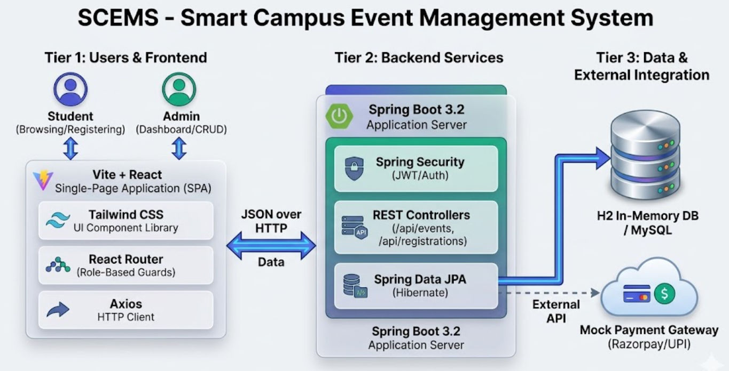
PROPOSED SYSTEM ARCHITECTURE
1
2
3
4
5
6
7
8
9

Slide 7
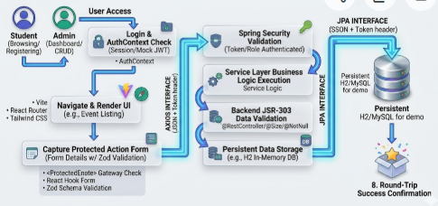
WORKFLOW
1
2
3
4
5
6
7
8
9

Slide 8
TECHNOLOGIES USED
Frontend Framework: React.js (v18+)
Build Tool: Vite
Styling & UI: Tailwind CSS, Framer Motion
Routing & Validation: React Router DOM, Zod, React Hook Form
Data Visualization: Recharts
Backend Architecture: Spring Boot (Java), Spring Security, Hibernate/JPA
Database: H2 In-Memory Database (Embedded relational database, acts like MySQL/
during development)
API Communication: Axios
Mock Integrations: Simulated Payment Gateway (UPI/Card)
1
2
3
4
5
6
7
8
9

Slide 9
MODULE DESCRIPTION
Module 1: User Management
Handles user registration, secure login, and session management.
Implements role-based access control to differentiate students and instructors.
Ensures secure password handling and controlled system access.
Module 2: Core Processing
Handles user registration, secure login, and session management.
Implements role-based access control to differentiate students and instructors.
Ensures secure password handling and controlled system access.
1
2
3
4
5
6
7
8
9

Slide 10
MODULE DESCRIPTION
Module 3: Database Management
Enables students to submit enrollment requests for courses.
Allows instructors to approve or reject requests through a controlled workflow.
Maintains enrollment status and ensures structured access to courses.
Module 4: Reporting & Analytics
Tracks student learning progress and updates completion percentage.
Generates AI-based course recommendations based on user activity and preferences.
Provides analytical insights to enhance personalized learning experience.
1
2
3
4
5
6
7
8
9

Slide 11
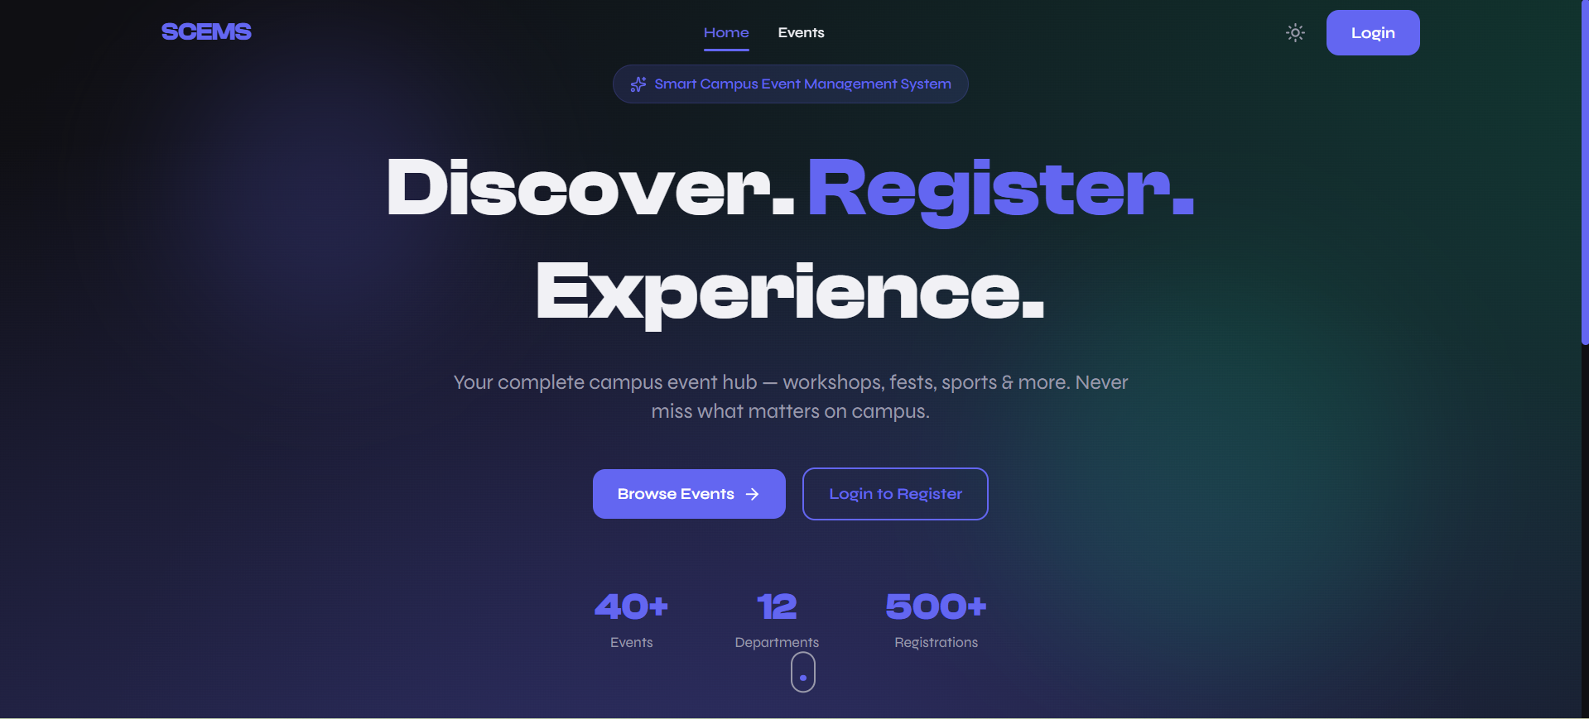
IMPLEMENTATION SCREENSHOTS
Home Page:
1
2
3
4
5
6
7
8
9
The Home Page provides an overview of the platform with navigation options for login, and dashboard access. It serves as the primary entry point to the system.

Slide 12
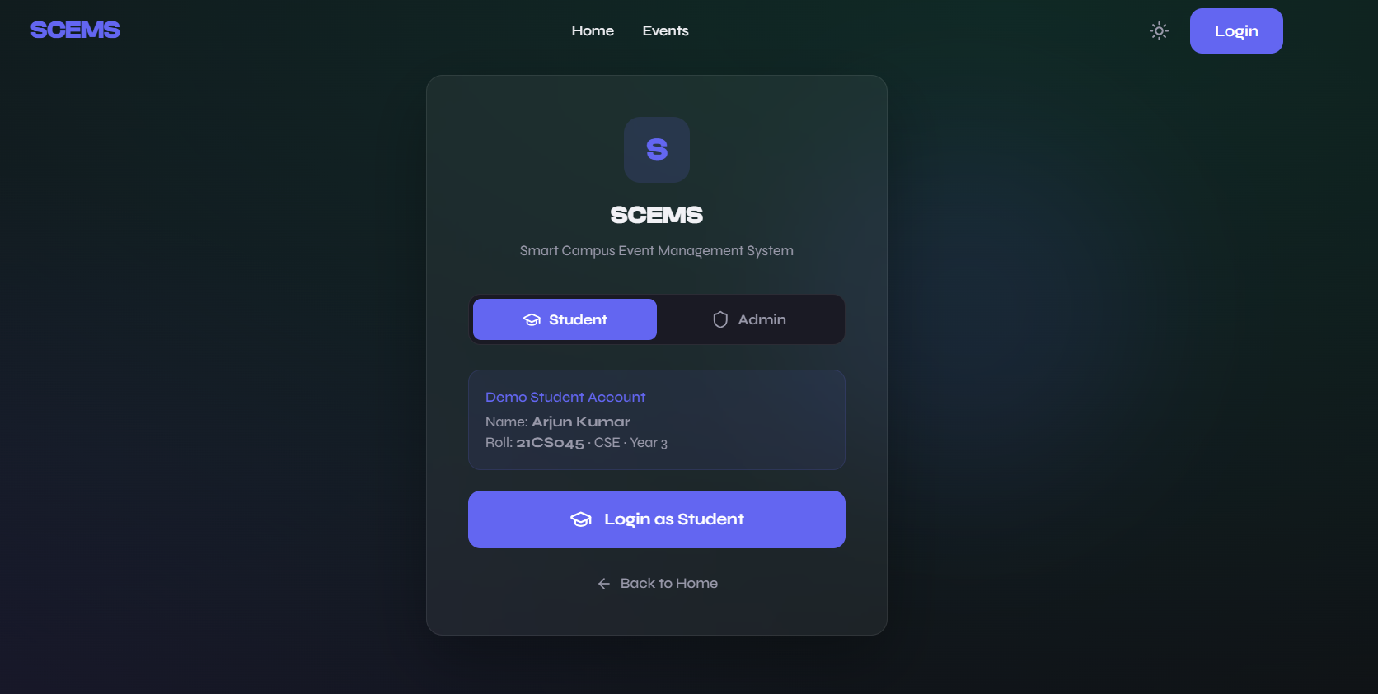
IMPLEMENTATION SCREENSHOTS
2. Login Page :
1
2
3
4
5
6
7
8
9
The Login Page implements secure authentication using role-based access control for students and instructors. It ensures controlled system access through session management.

Slide 13
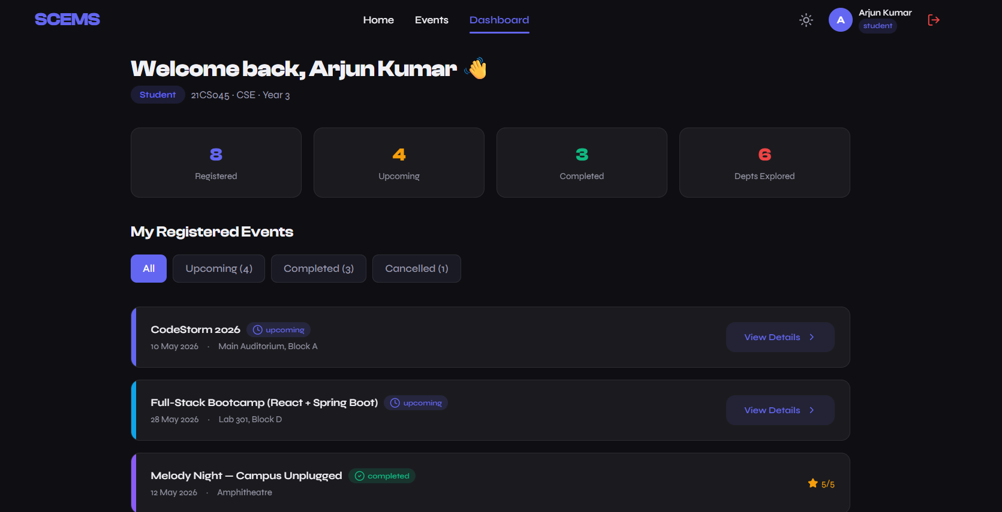
IMPLEMENTATION SCREENSHOTS
3. Student Dashboard :
1
2
3
4
5
6
7
8(A)
9
The Student Dashboard allows users to view available events registering options

Slide 14
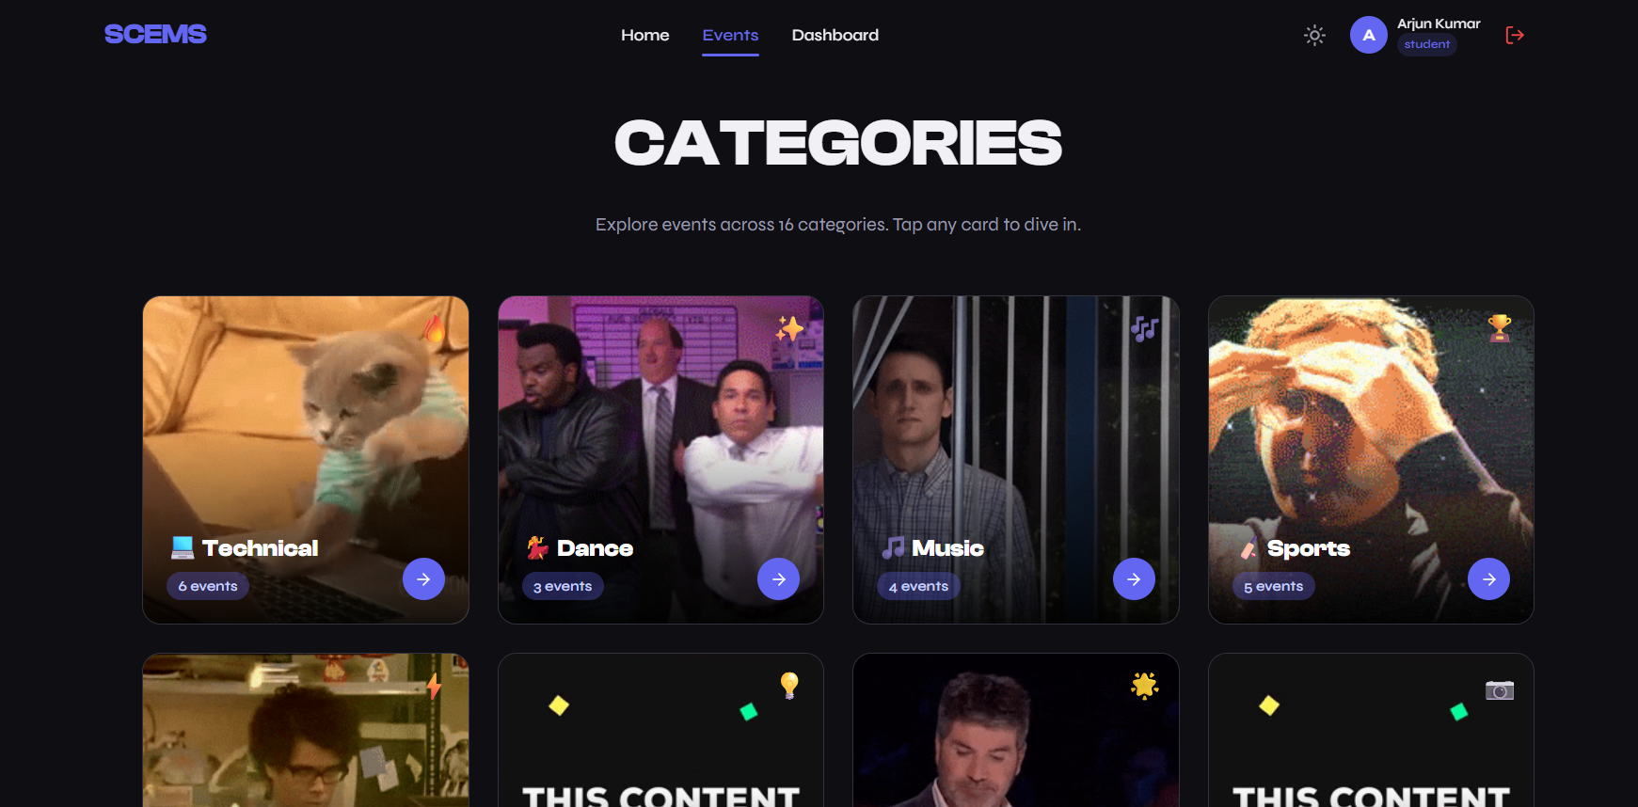

Slide 15
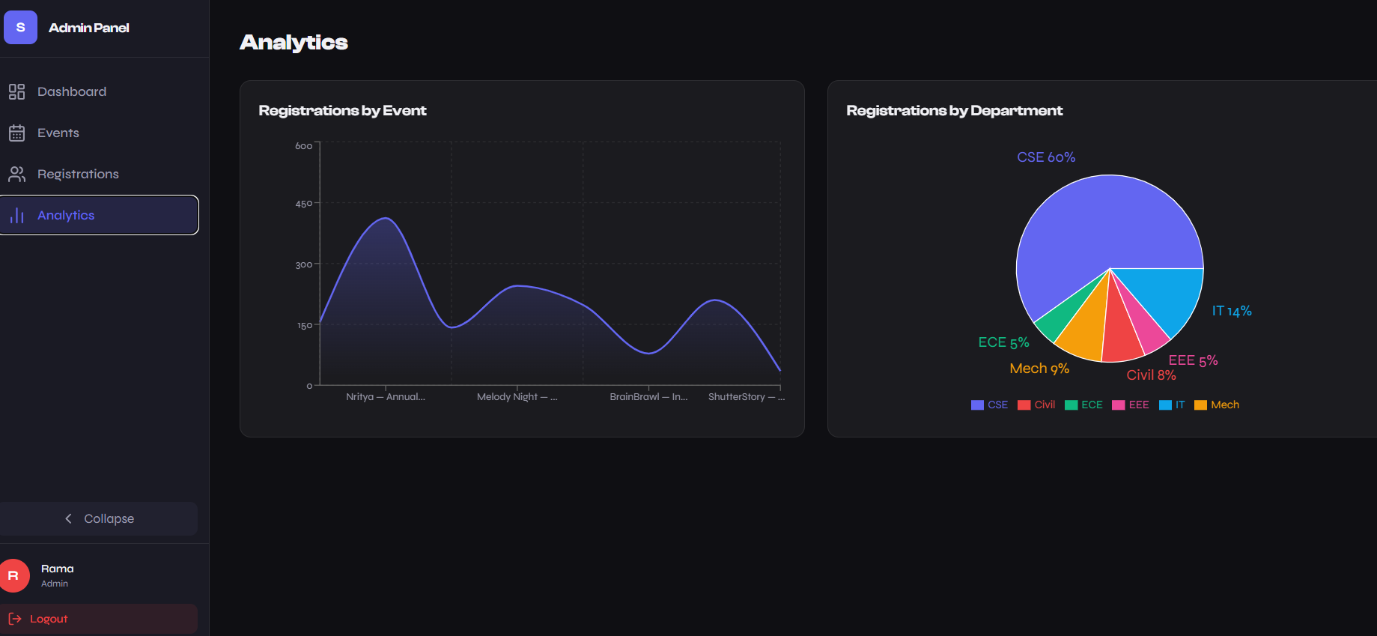
IMPLEMENTATION SCREENSHOTS
4. Admin Dashboard :
1
2
3
4
5
6
7
8(B)
9
The Admin Dashboard enables graphs,charts and enrollment approval management. It also provides analytical insights for monitoring student participation and course performance.

Slide 16
ADVANTAGES & LIMITATIONS
ADVANTAGES:
Centralized Event Hub: Eliminates information fragmentation across WhatsApp groups and notice boards, providing a single premium platform for all campus activities.
Intuitive & Engaging UI: Features a modern "Glassmorphism" aesthetic with smart, multi-step registration forms and animations (confetti) that significantly boost student engagement.
Streamlined Administration: Offers dedicated dashboards with real-time analytics (Recharts) and secure role-based control (RBAC) to replace messy manual data entry processes.
1
2
3
4
5
6
LIMITATIONS :
Simulated Core Services: Critical backend features, specifically live JWT-based Authentication and the Payment Gateway, are currently mocked simulations prepared for full integration.
Volatile Data Persistence: The system utilizes an H2 In-Memory database for development purposes, meaning all data is reset and lost upon every server restart.
Active Internet Dependency: As a full-stack web Single-Page Application (SPA), continuous network connectivity is mandatory to access dashboards or complete registrations.
7
8
9

Slide 17
Thank you

